Slide 1
State Space Analysis
UNIT-V

Slide 2
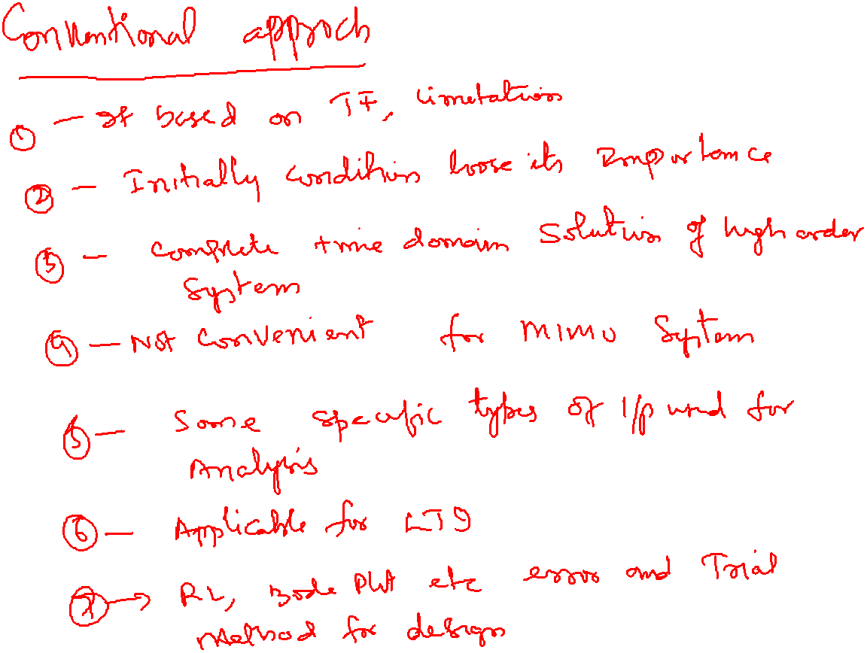

Slide 3
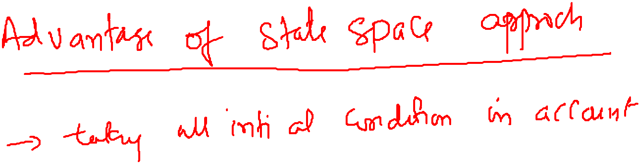
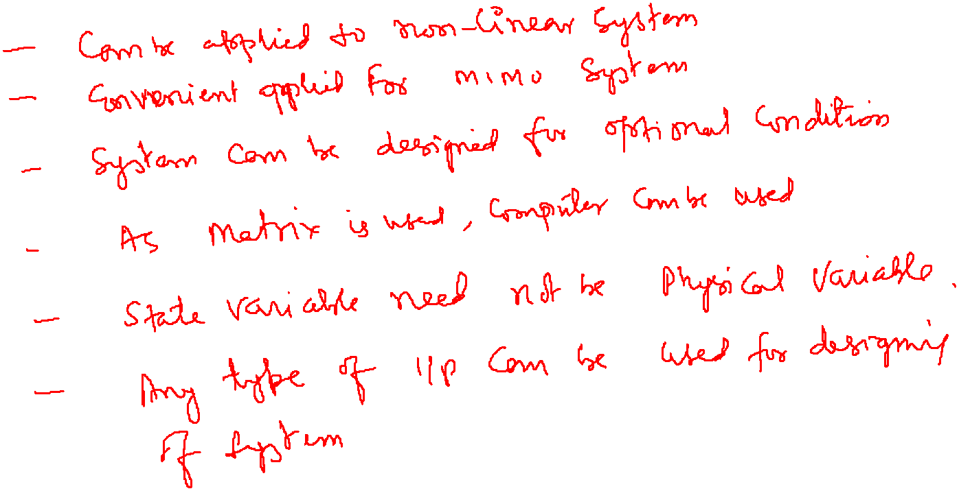

Slide 4
outline
How to find mathematical model, called a state-space representation, for a linear, time-invariant system
How to convert between transfer function and state space models

Slide 5
State-Space Modeling
Alternative method of modeling a system than
Differential / difference equations
Transfer functions
Uses matrices and vectors to represent the system parameters and variables
5
Notes:
5

Slide 6
State-Space Modeling
In control engineering, a state space representation is a mathematical model of a physical system as a set of input, output and state variables related by first-order differential equations. To abstract from the number of inputs, outputs and states, the variables are expressed as vectors.
6
Notes:
6

Slide 7
Motivation for State-Space Modeling
Easier for computers to perform matrix algebra
e.g. MATLAB does all computations as matrix math
Handles multiple inputs and outputs
Provides more information about the system
Provides knowledge of internal variables (states)
Primarily used in complicated, large-scale systems
7
Notes:
7

Slide 8
Definitions
State- The state of a dynamic system is the smallest set of variables (called state variables) such that knowledge of these variables at t=t0 , together with knowledge of the input for t ≥ t0 , completely determines the behavior of the system for any time t to t0 .
Note that the concept of state is by no means limited to physical systems. It is applicable to biological systems, economic systems, social systems, and others.

Slide 9
State Variables:
The state variables of a dynamic system are the variables making up the smallest set of variables that determine the state of the dynamic system.
If at least n variables x1, x2, …… , xn are needed to completely describe the behavior of a dynamic system (so that once the input is given for t ≥ t0 and the initial state at t=t0 is specified, the future state of the system is completely determined), then such n variables are a set of state variables.
Notes:
9

Slide 10
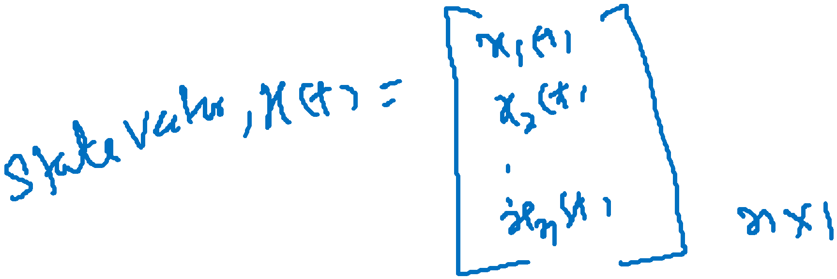
State Vector:
A vector whose elements are the state variables.
If n state variables are needed to completely describe the behavior of a given system, then these n state variables can be considered the n components of a vector x. Such a vector is called a state vector.
A state vector is thus a vector that determines uniquely the system state x(t) for any time t≥ t0, once the state at t=t0 is given and the input u(t) for t ≥ t0 is specified.

Slide 11
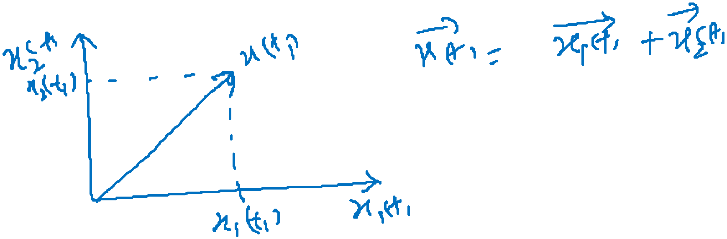
State Space:
The n-dimensional space whose coordinate axes consist of the x1 axis, x2 axis, ….., xn axis, where x1, x2,…… , xn are state variables, is called a state space.
"State space" refers to the space whose axes are the state variables. The state of the system can be represented as a vector within that space.

Slide 12
State-Space Equations. In state-space analysis we are concerned with three types of variables that are involved in the modeling of dynamic systems: input variables, output variables, and state variables.
The number of state variables to completely define the dynamics of the system is equal to the number of integrators involved in the system.

Slide 13
State-Space Equations.
Assume that a multiple-input, multiple-output system involves n integrators. Assume also that there are r inputs
u₁(t), u₂(t),……. u_{r}(t)
and m outputs
y₁(t), y₂(t), …….. y_{m}(t). ..(2.1)

Slide 14
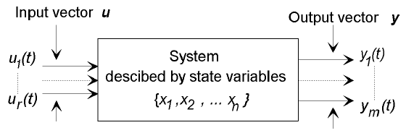
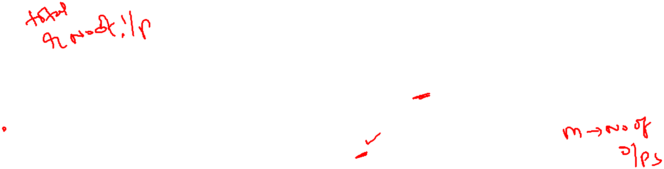
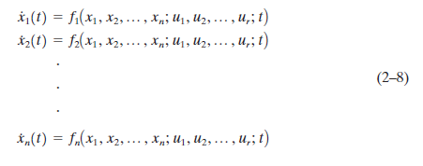
Define n outputs of the integrators as state variables: x₁(t), x₂(t), ……… x_{n}(t). Then the system may be described by
1

Slide 15
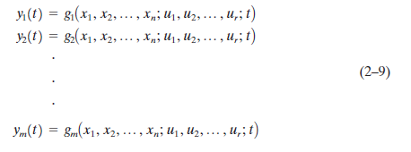
The outputs y₁(t), y₂(t), ……… y_{m}(t) of the system may be given by
2

Slide 16
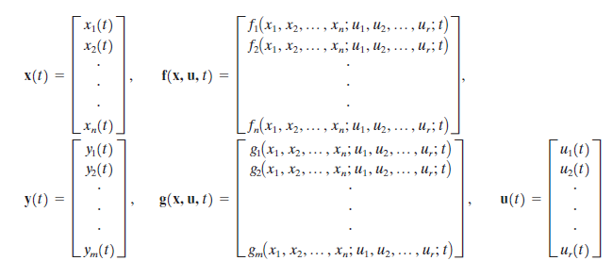
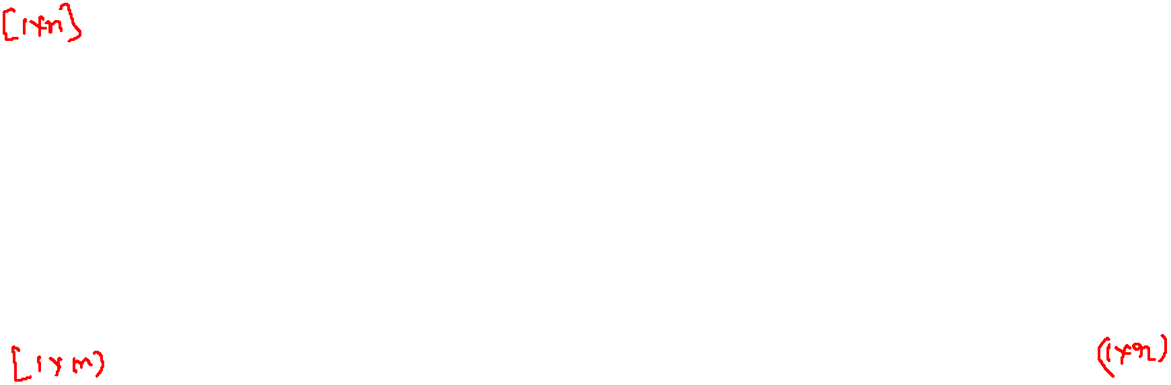

If we define

Slide 17


then Equations (2–8) and (2–9) become
3
4
where Equation (3) is the state equation and Equation (4) is the output equation. If vector functions f and/or g involve time t explicitly, then the system is called a time varying system.

Slide 18

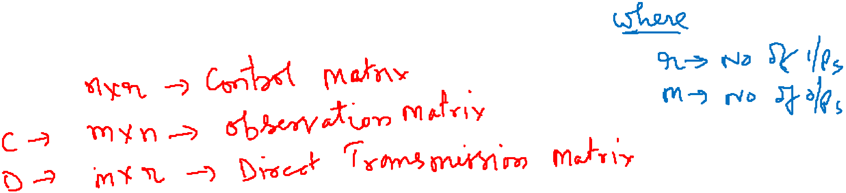
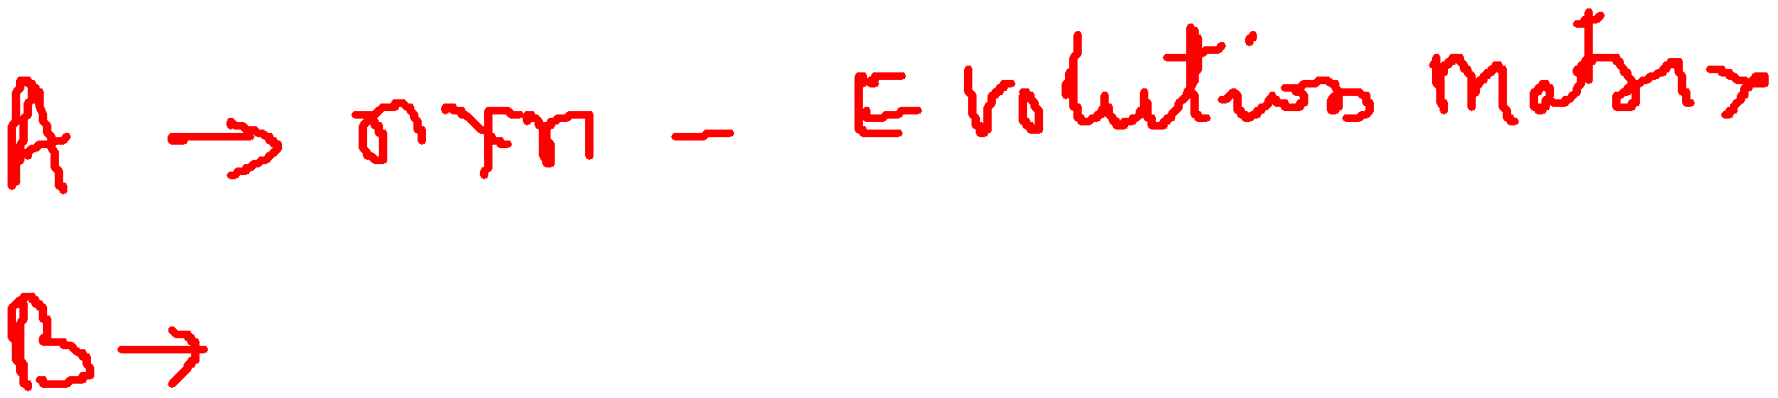

If Equations (3) and (4) are linearized about the operating state, then we have the following linearized state equation and output equation:
5
6

Slide 19
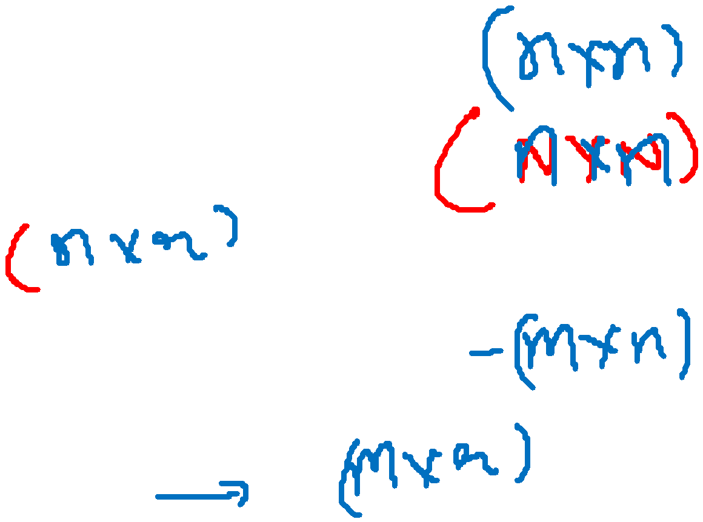
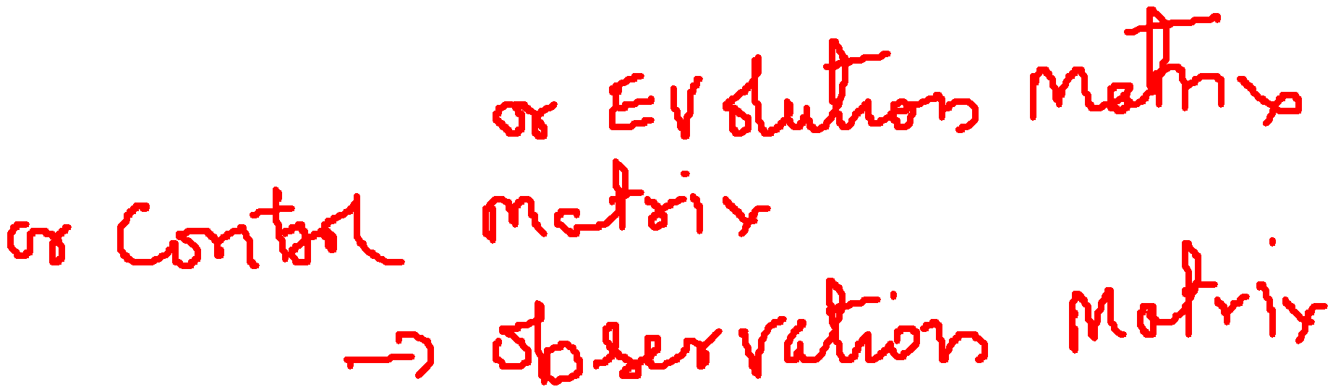
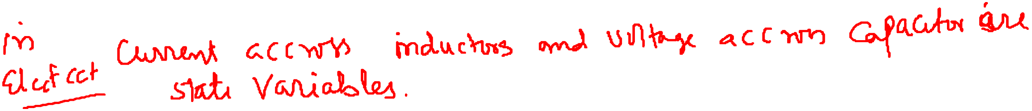
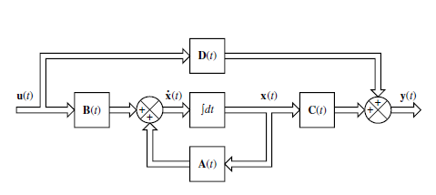
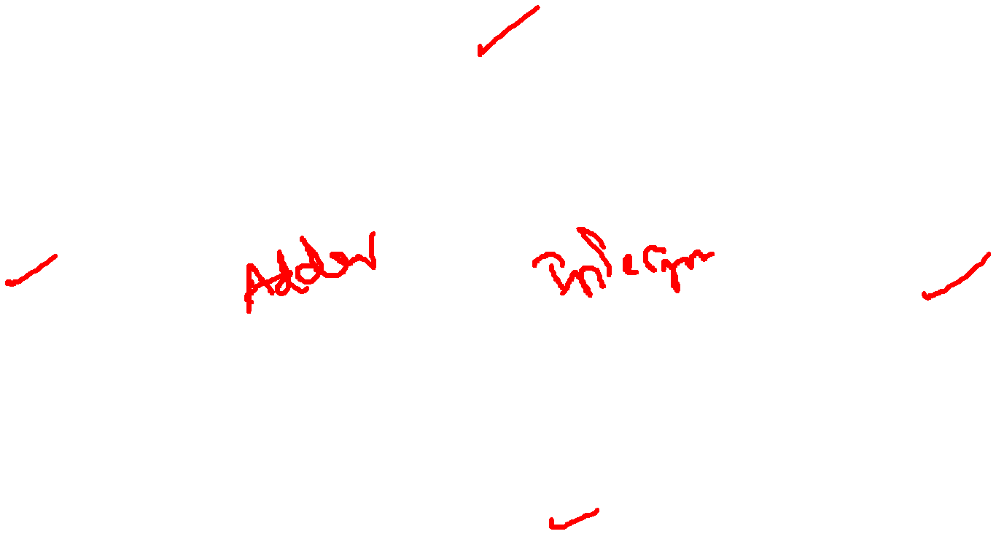
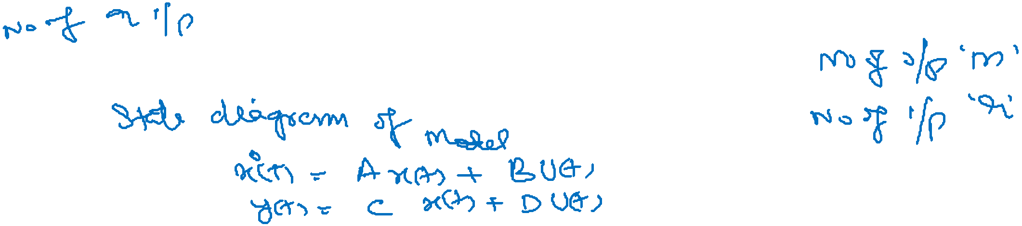
A(t) is called the state matrix,
B(t) the input matrix,
C(t) the output matrix, and
D(t) the direct transmission matrix.
A block diagram representation of Equations (5) and (6) is shown in Figure

Slide 20
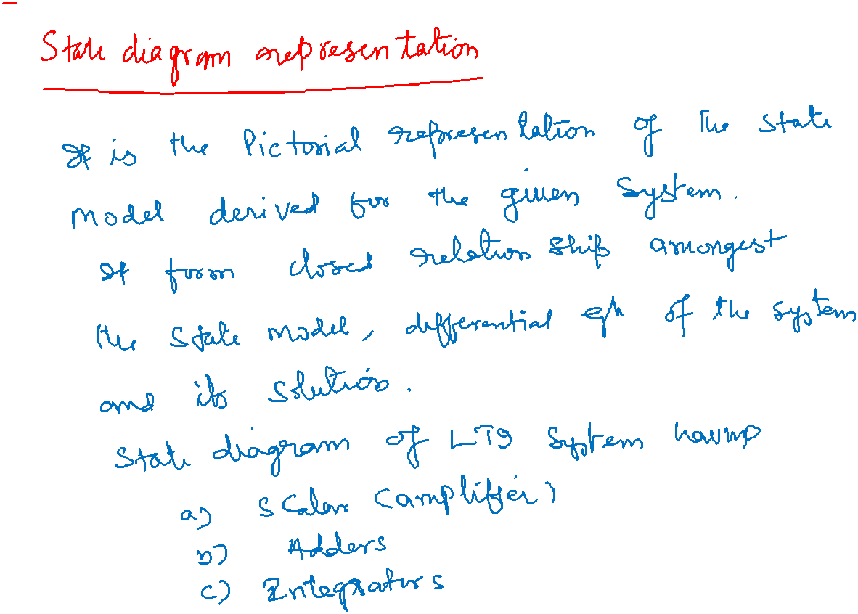

Slide 21

If vector functions f and g do not involve time t explicitly then the system is called a time-invariant system. In this case, Equations (5) and (6) can be simplified to
7
8
Equation (7) is the state equation of the linear, time-invariant system and
Equation (8) is the output equation for the same system.

Slide 22

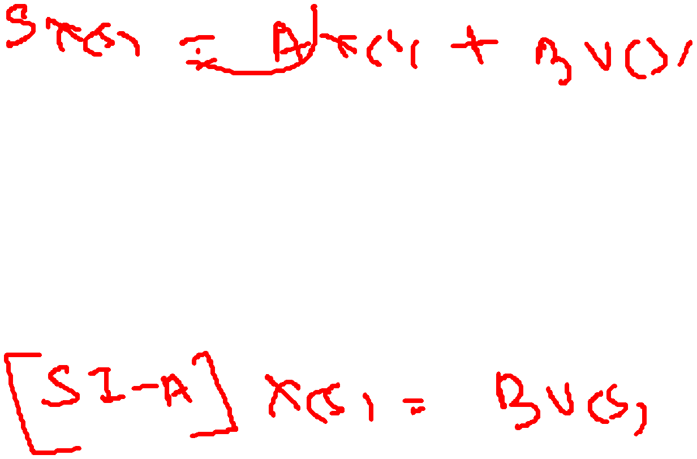

Correlation Between Transfer Functions and State-Space Equations
The "transfer function" of a continuous time-invariant linear state-space model can be derived in the following way:
First, taking the Laplace transform of
Yields

Slide 23
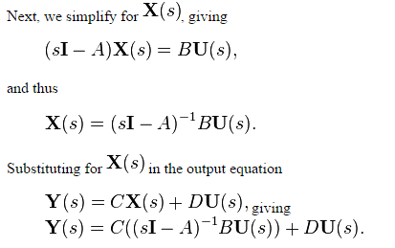


Slide 24
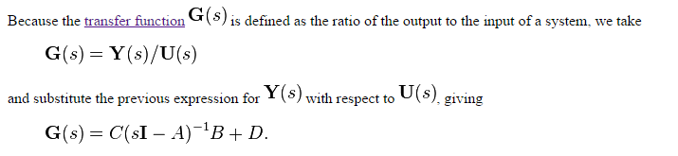

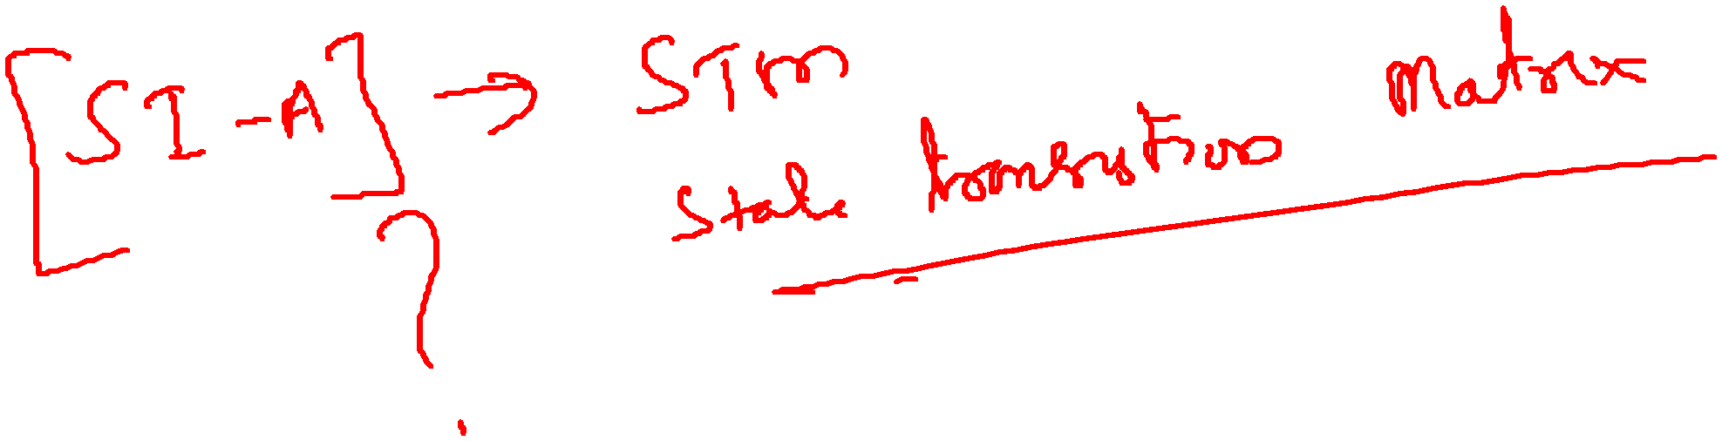

Slide 25

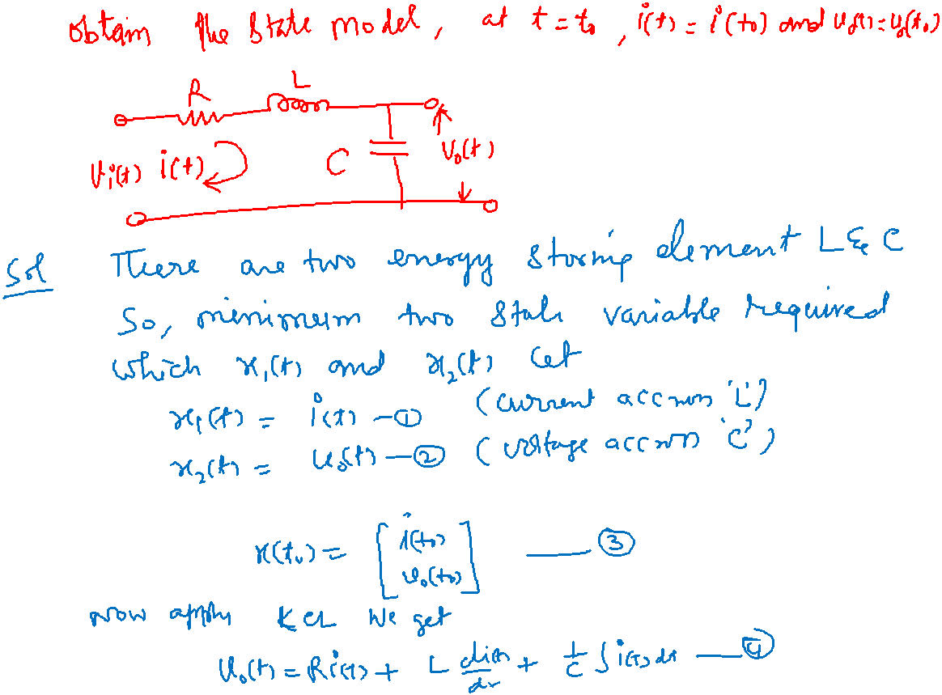

Slide 26
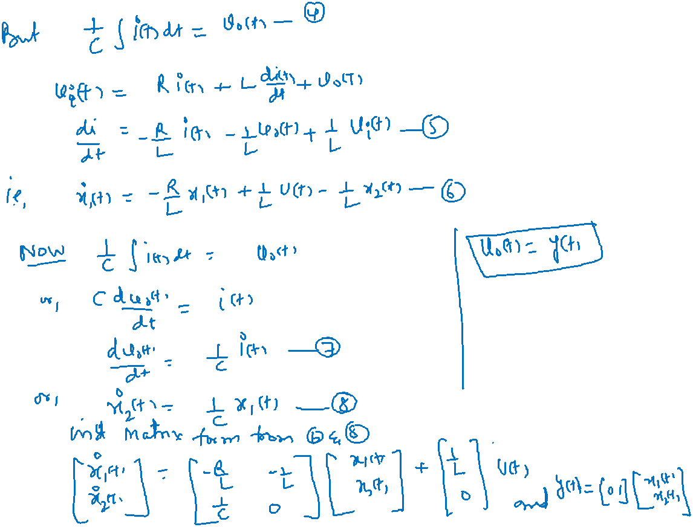

Slide 27
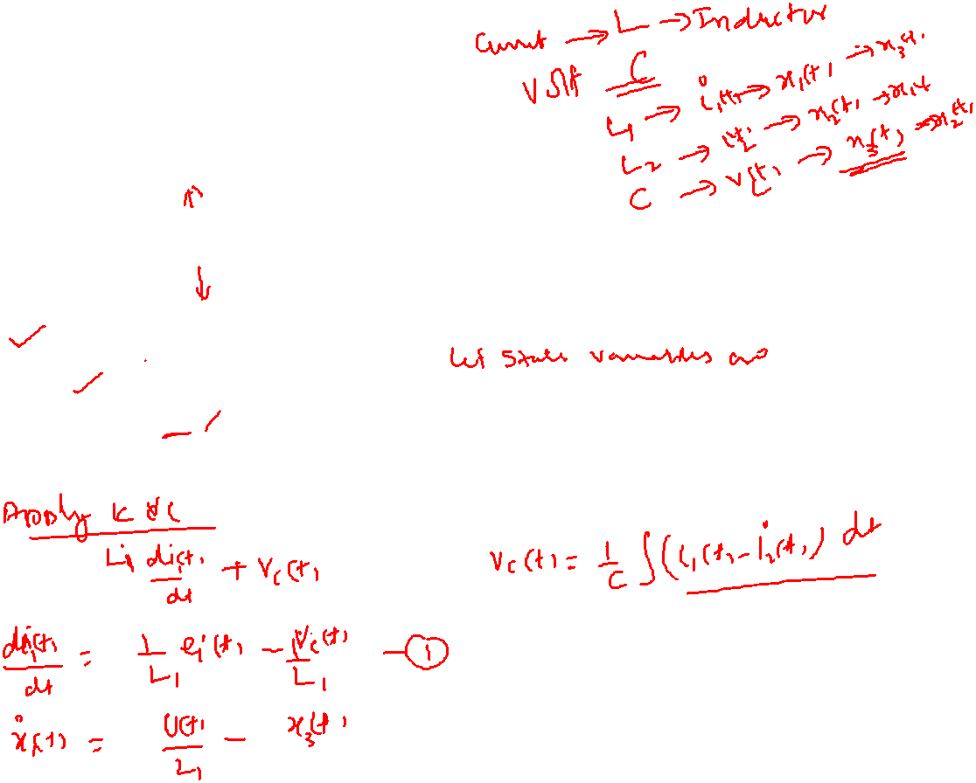
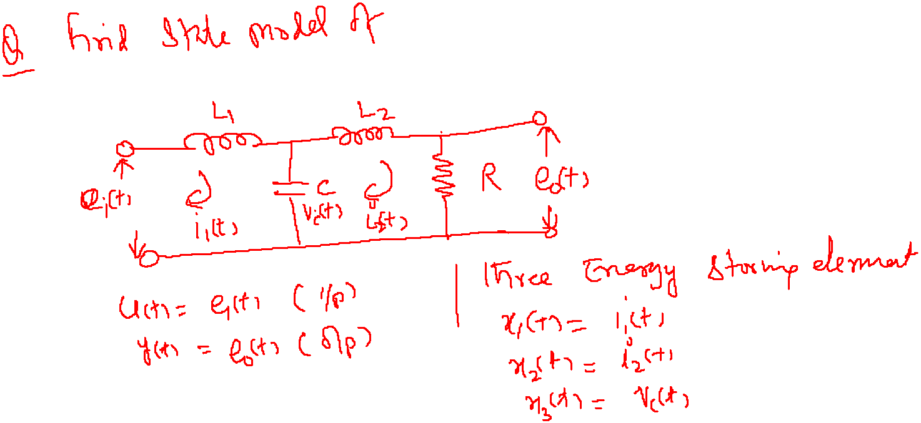
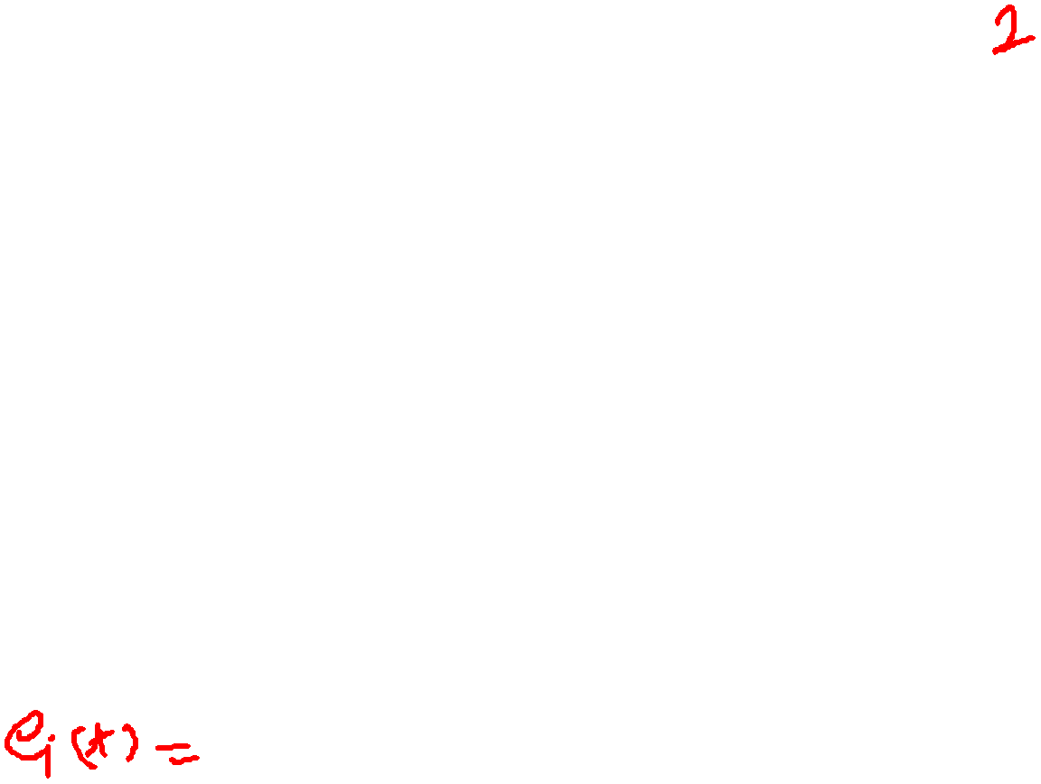
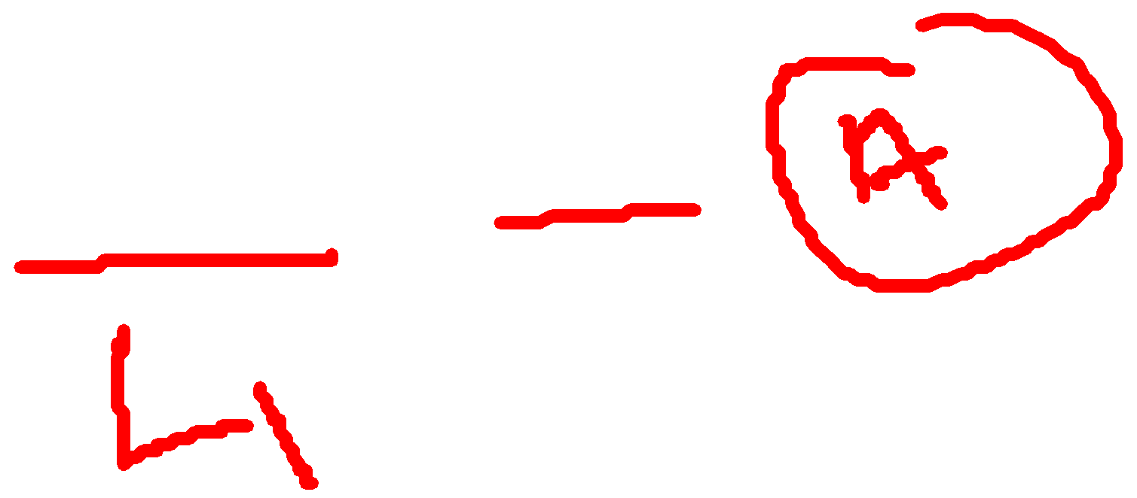

Slide 28
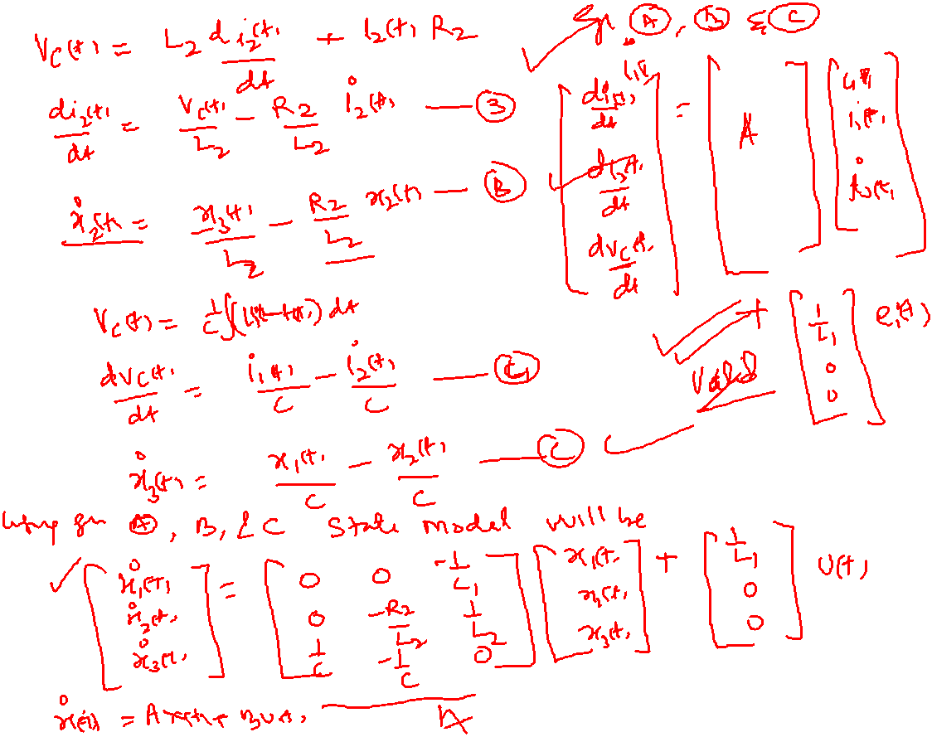

Slide 29
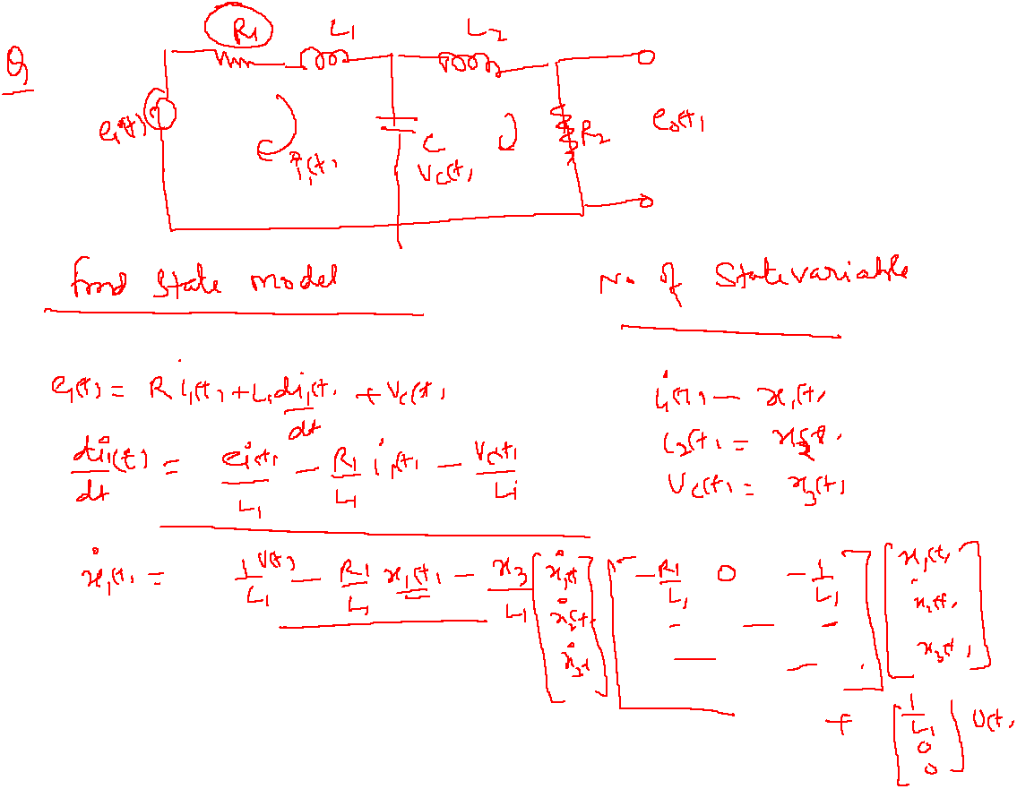

Slide 30
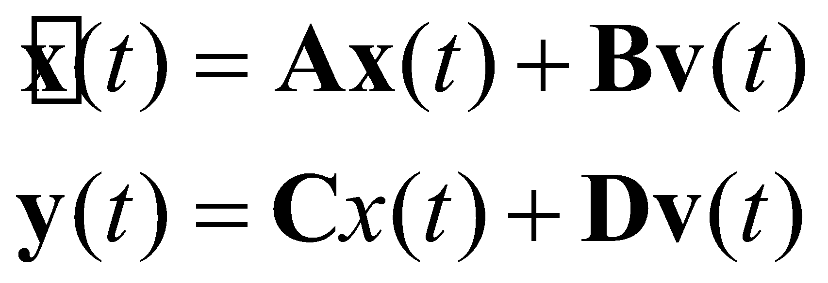
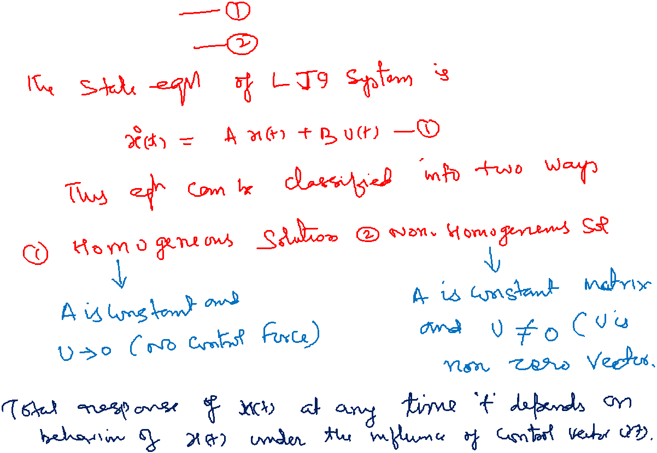
Solutions to the State Equations – Preliminaries
Notes:
]i=k,
30

Slide 31
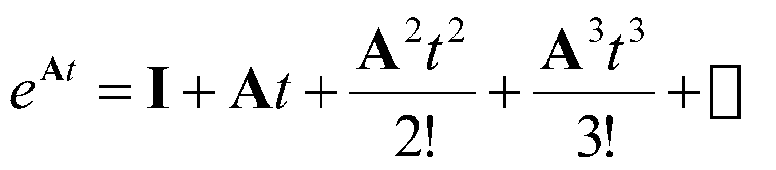
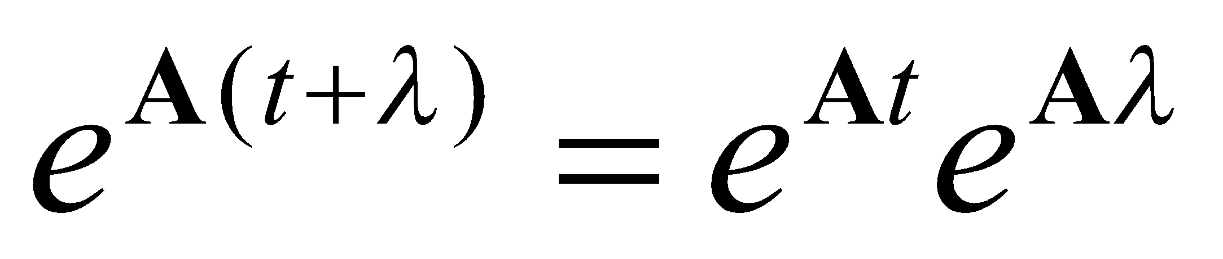
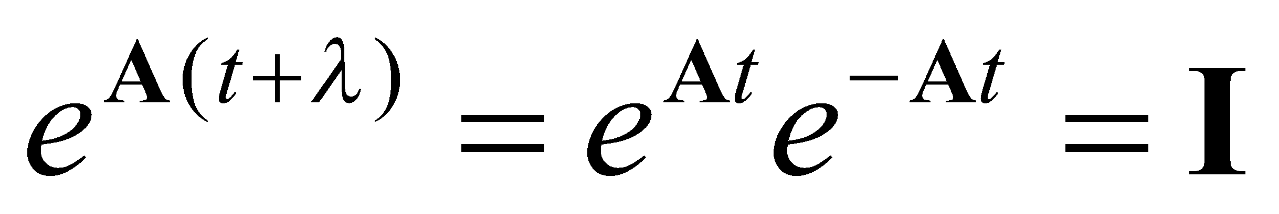
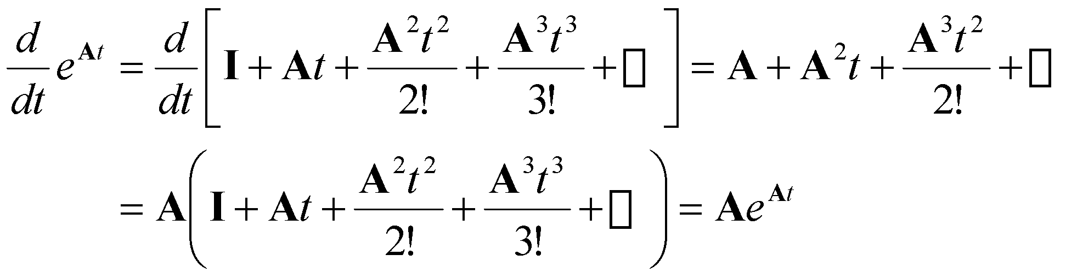
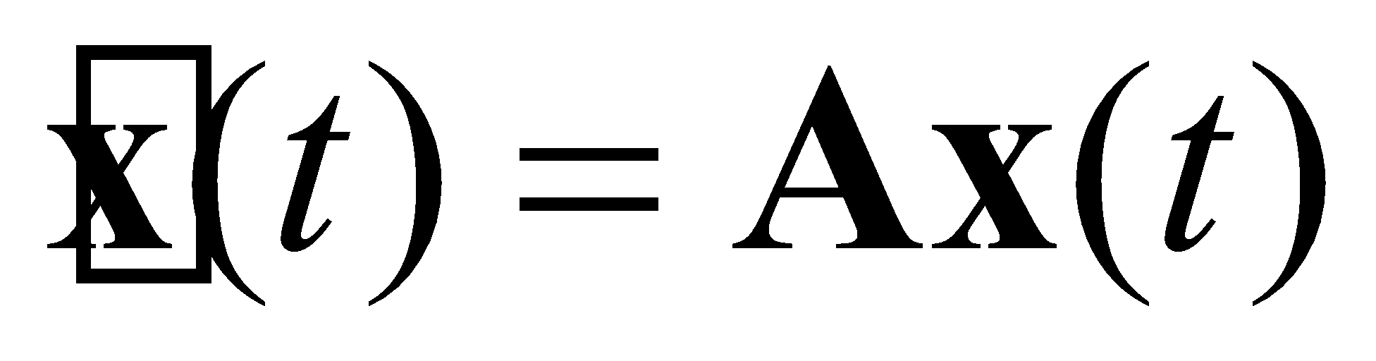
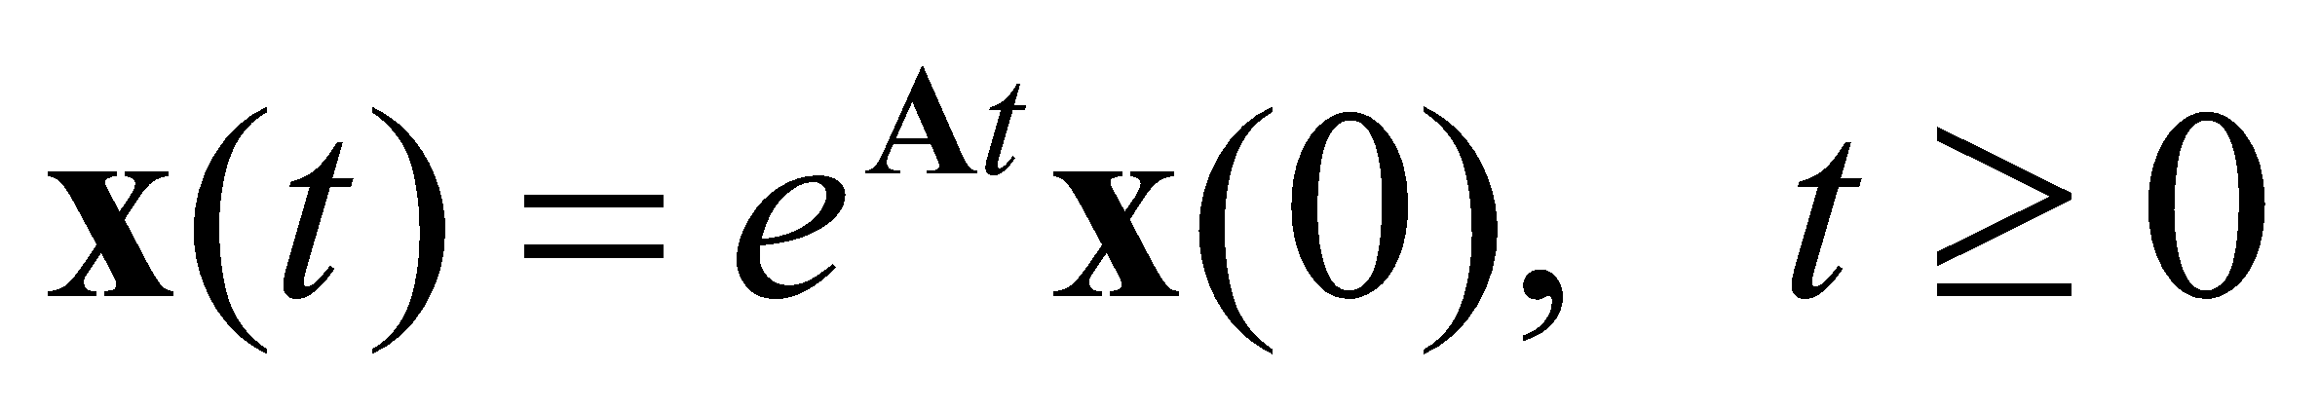
Solutions to the State Equations – Preliminaries
Recall our state equations:
To solve these equations, we will need a few mathematical tools. First:
where I is an NxN identity matrix. A^{k} is simply AxAx…A.
For any real numbers t and λ:
Further, setting λ = -t:
Next:
We can use these results to show that the solution to is:
Notes:
]i=k,
31

Slide 32
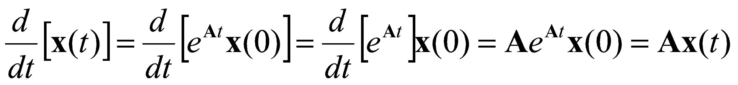
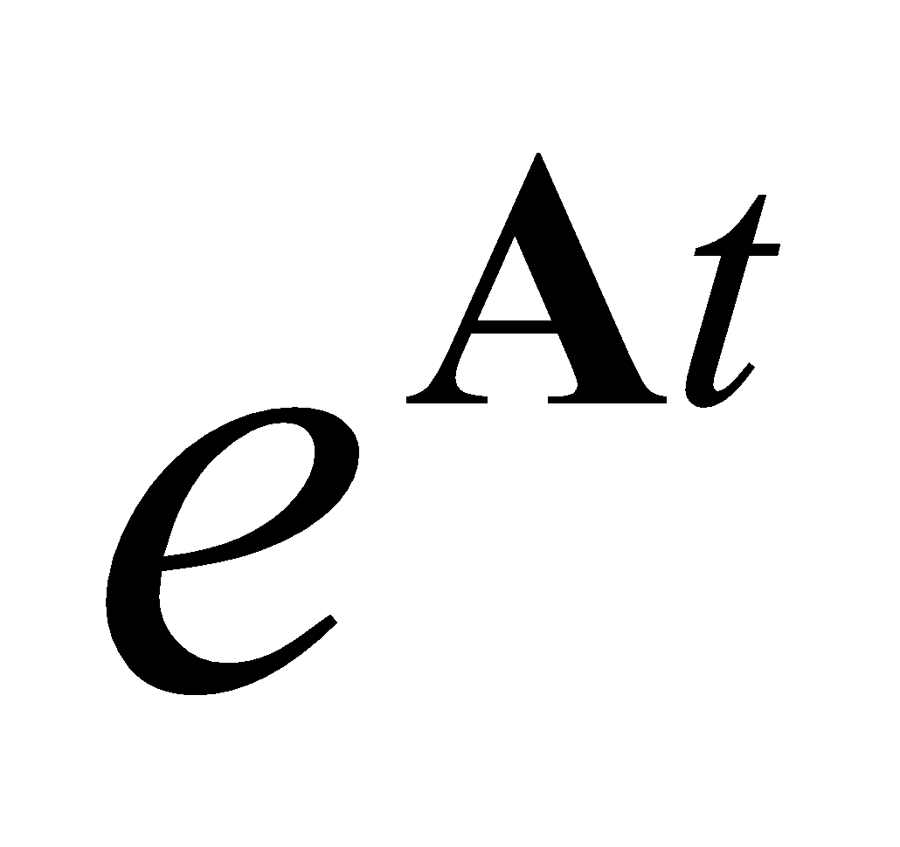
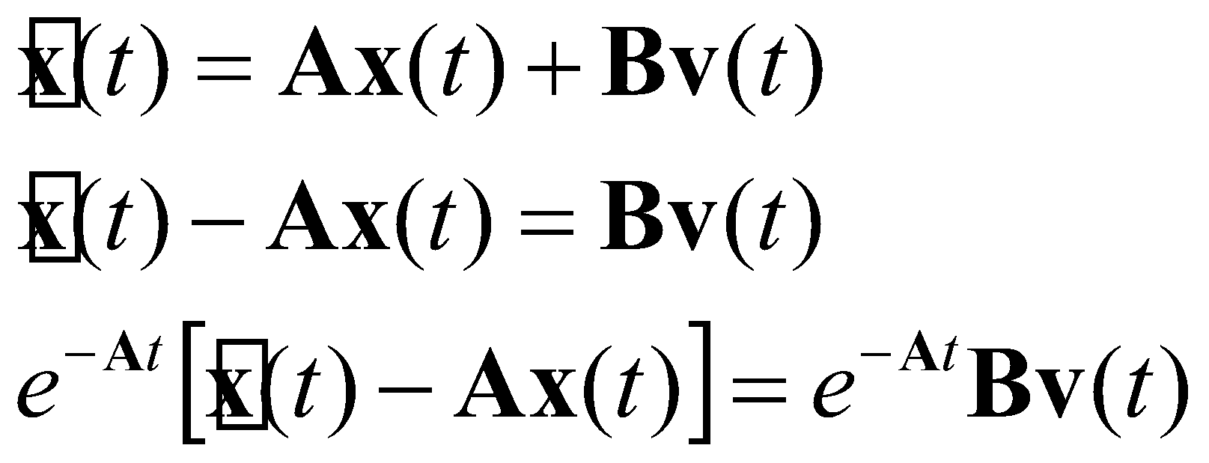
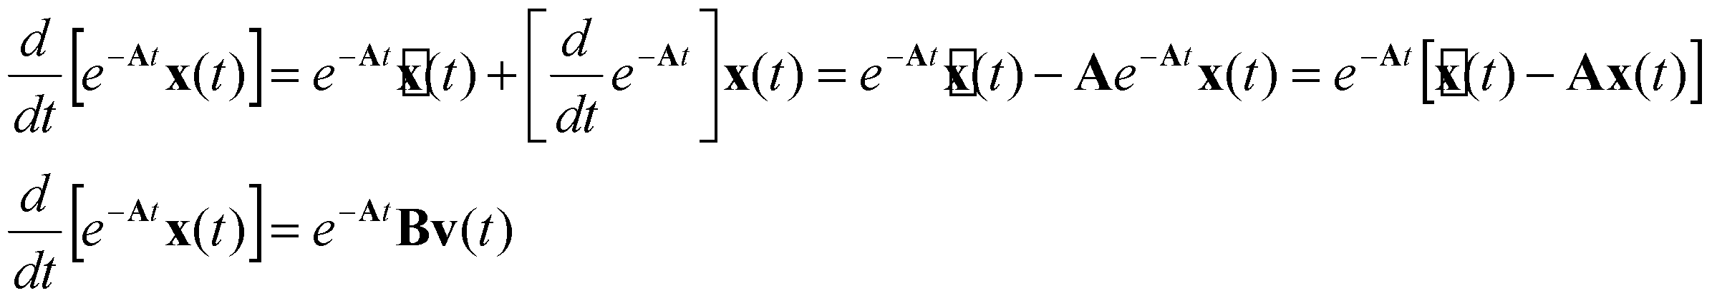
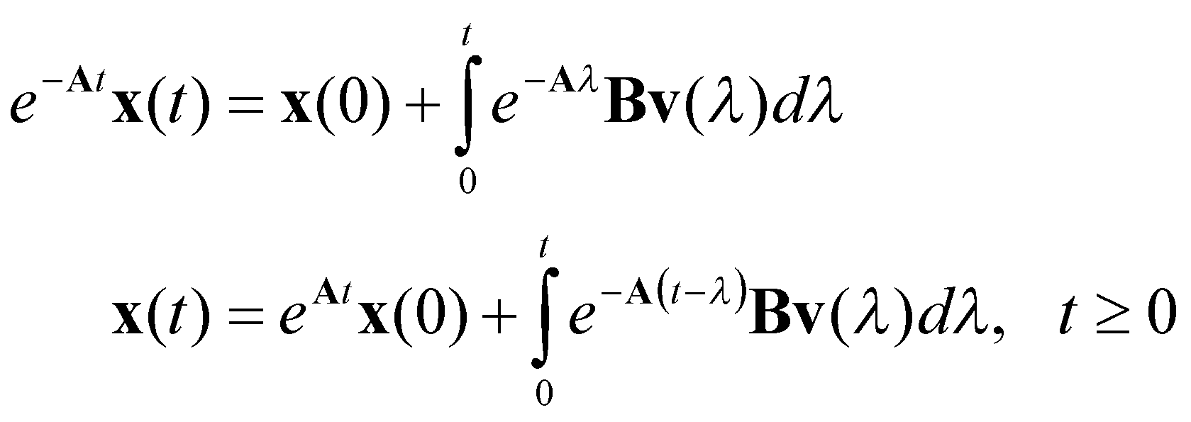
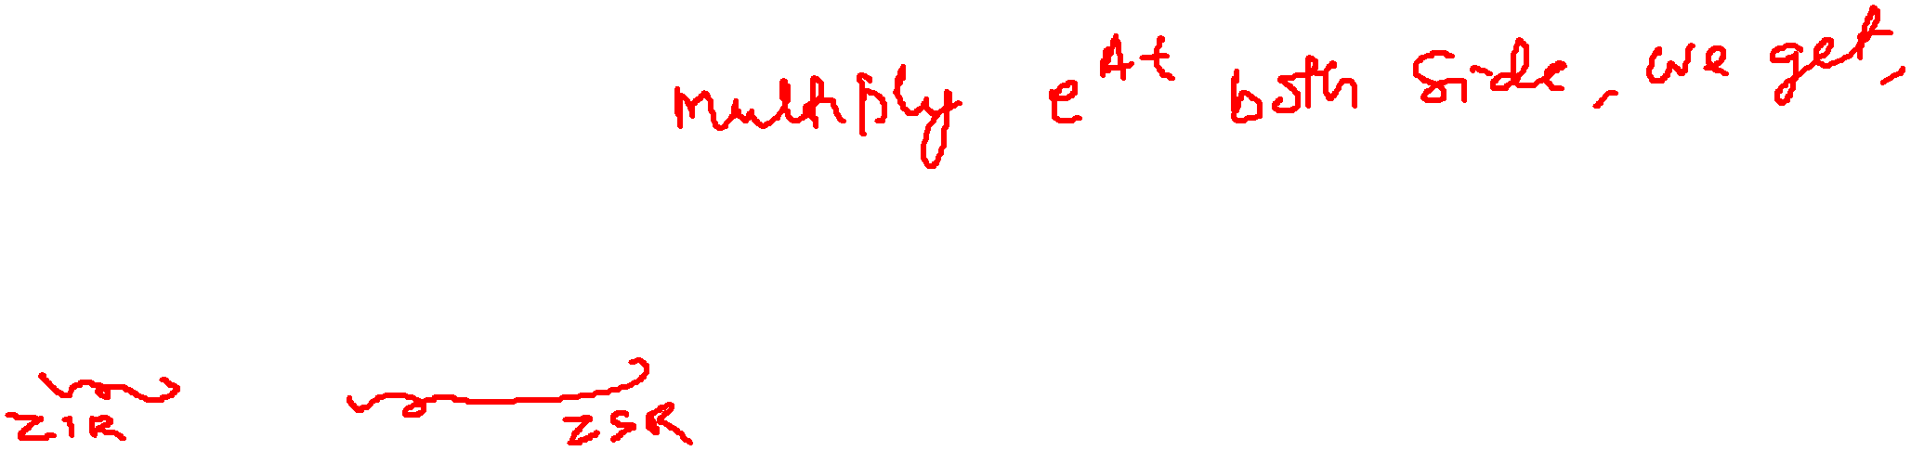
Solutions to the Forced Equation
If:
is referred to as the state-transition matrix.
We can apply these results to the state equations:
Note that:
Integrating both sides:
Generalization of our convolution integral
Notes:
]i=k,
32

Slide 33
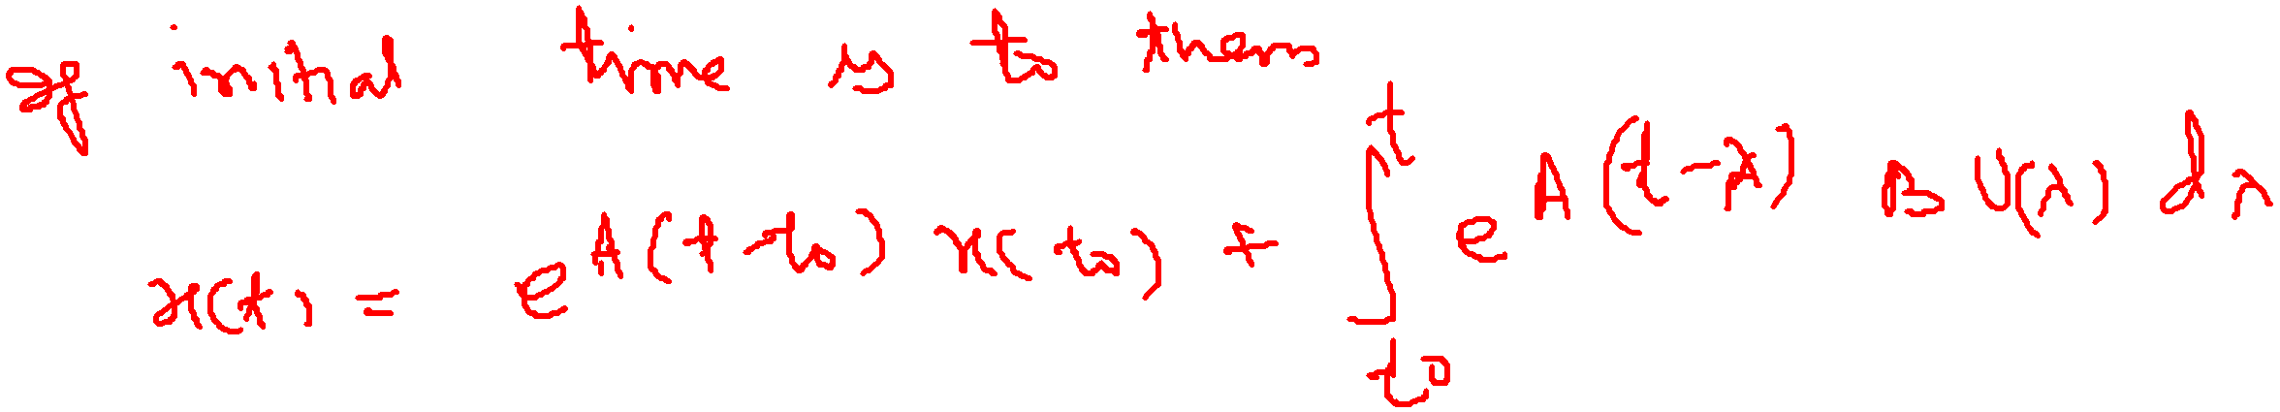
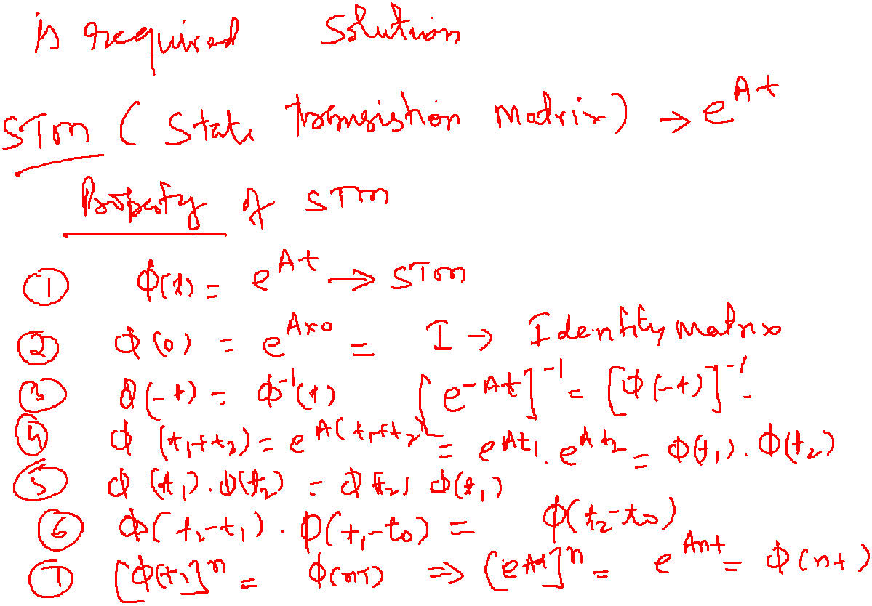


Slide 34
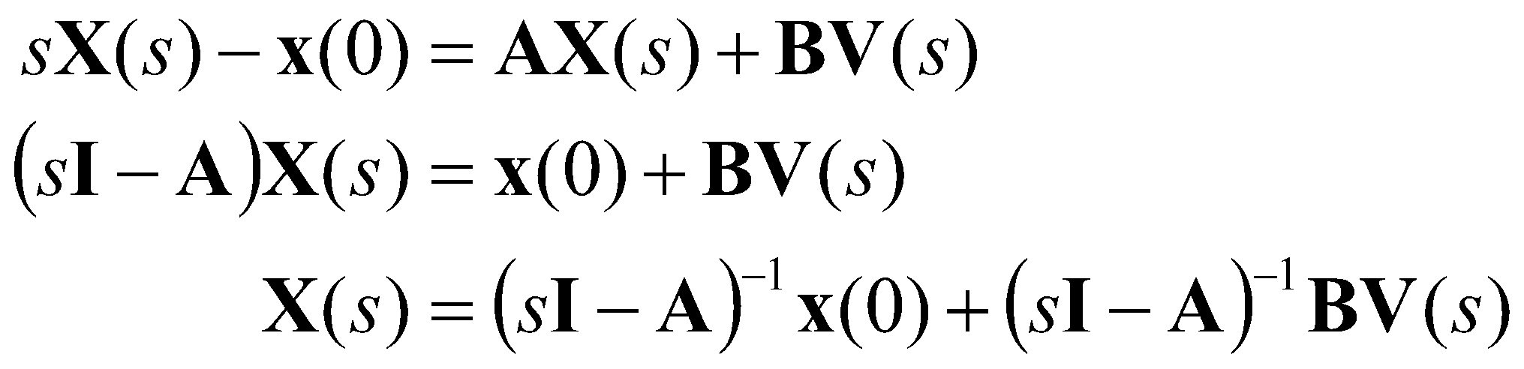
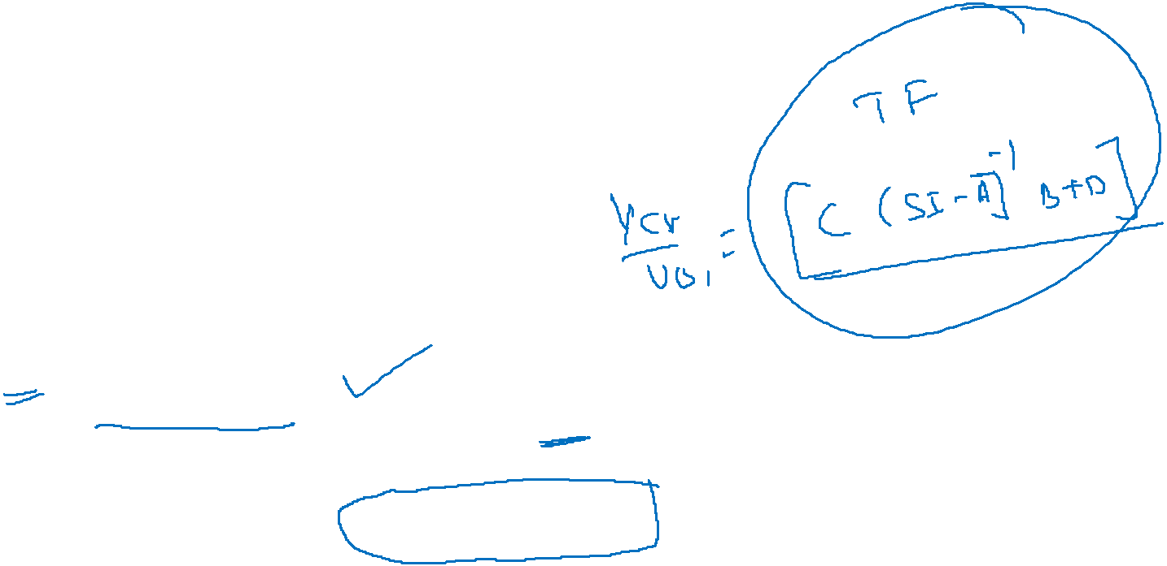



Solution via the Laplace Transform
Recall our state equations:
Using the Laplace transform on the first equation:
Comparing this to:
reveals that:
Continuing with the output equation:
For zero initial conditions:
The transfer function can be computed directly from the system parameters.
Notes:
]i=k,
34

Slide 35


Slide 36


Slide 37


Slide 38


Slide 39


Slide 40


Slide 41


Slide 42


Slide 43


Slide 44


Slide 45


Slide 46




Slide 47





State model from Differential Equations
This can be extended to an N^{th}-order differential equation of this type:
Notes:
]i=k,
47

Slide 48



Slide 49

Differential Equations (Cont.)
The resulting state equations are:
Notes:
]i=k,
49

Slide 50




Slide 51



Slide 52



Differential Equations
Consider the CT differential equations:
A second-order differential equation requires two state variables:
We can reformulate the differential equation as a set of three equations:
Notes:
]i=k,
52

Slide 53


Differential Equations
We can write these in matrix form as:
Notes:
]i=k,
53

Slide 54



Slide 55


Slide 56


Slide 57


Slide 58


Slide 59


Slide 60



Slide 61


